Slide 1

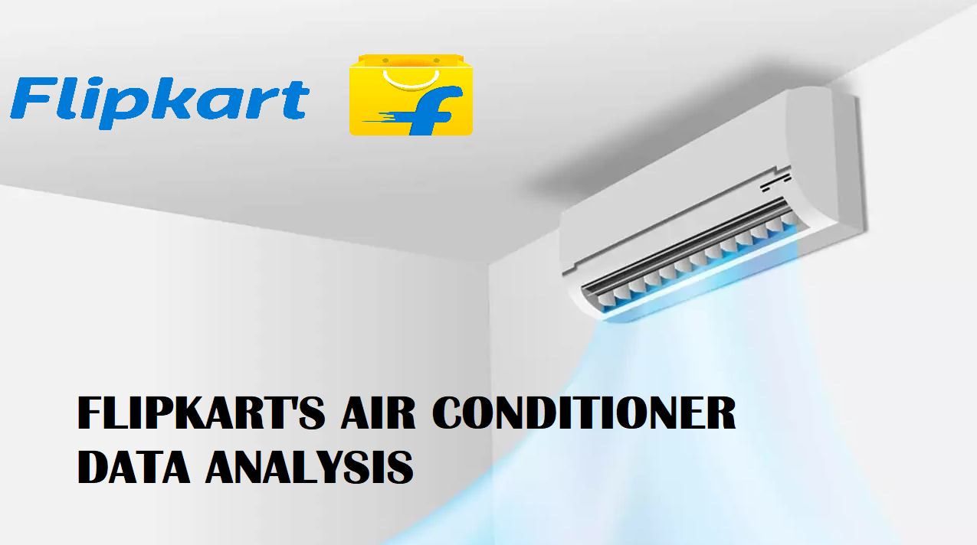
Title: Web Scraping and Exploratory Data Analysis of AIR CONDITIONER

Slide 2
About ME:
I am Buddepu Vivek from Innomatics research labs, with strong interest in exploratory data analytics (EDA).
Skilled in data collection, cleaning, and visualization using python and analytical tools.
Exploring data-driven insights through real-world datasets.
Interested in applying EDA techniques to understand business trends and improve data driven decisions.

Slide 3
Introduction:
Flipkart is one of India's leading e-commerce platforms, founded in 2007 by sachin bansal and binny bansal.
It started as an online bookstore and later expanded into various categories like electronics, fashion, and home appliances.
Among home appliances, air conditioners (Ac’s) are one of the major product categories on flipkart.
Flipkart offers a wide range of Ac’s from top brands such as lg, samsung, voltas, daikin, and whirlpool, catering to different price ranges and features.
The platform provides detailed product descriptions, specifications, ratings, and customer reviews to help users make informed choices.

Slide 4
Business Problem:
AC product data and customer feedback on flipkart are scattered across different sources and formats.
The business team faces challenges in analysing sales trends, comparing brand performance, and understanding customer preferences.
Customers often struggle to find the right ac based on usage needs, room size, or energy efficiency ratings.
There is a need for a unified analytics system that can combine sales, reviews, and performance data to help flipkart improve recommendations, optimize inventory, and support better business decisions.

Slide 5
Objectives:
This project focuses on performing exploratory data analysis (EDA) on flipkart air conditioner products.
Data was scraped directly from flipkart using web scraping techniques to collect product details such as brand, price, ratings, and specifications.
After data collection, we performed data cleaning, analysis, and visualization using python libraries like pandas, numpy, matplotlib, and seaborn.
The goal of this project is to identify pricing patterns, brand performance, and customer preferences based on flipkart product data.
To improve the sales of air conditioners on flipkart.

Slide 6
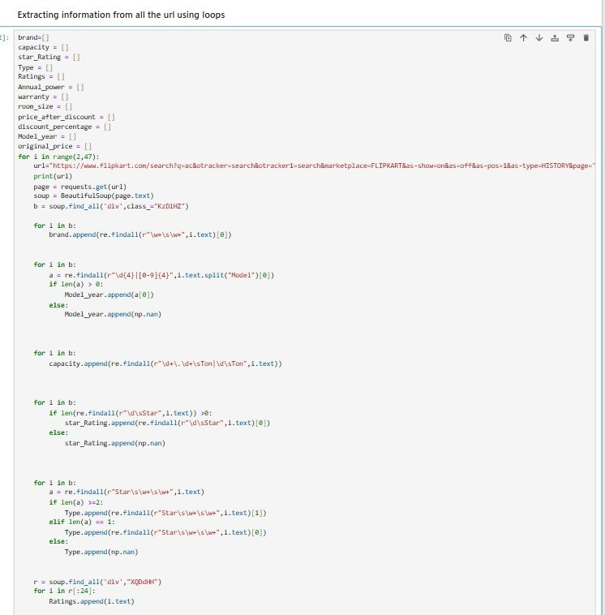
Web Scraping
We have selected flipkart website as the main source for data collection.
Used browser developer tools (Inspect Element) to locate and analyze HTML tags containing product details such as names, prices, and ratings on Flipkart’s AC listings.
Used requests and BeautifulSoup libraries in python to unstructured data from web pages
Using python automated the process for multiple pages
Used Pandas to clean and organize the scraped data, enabling clear visualization and analysis of pricing and brand performance trends.

Slide 7






Tools Used:

Slide 8
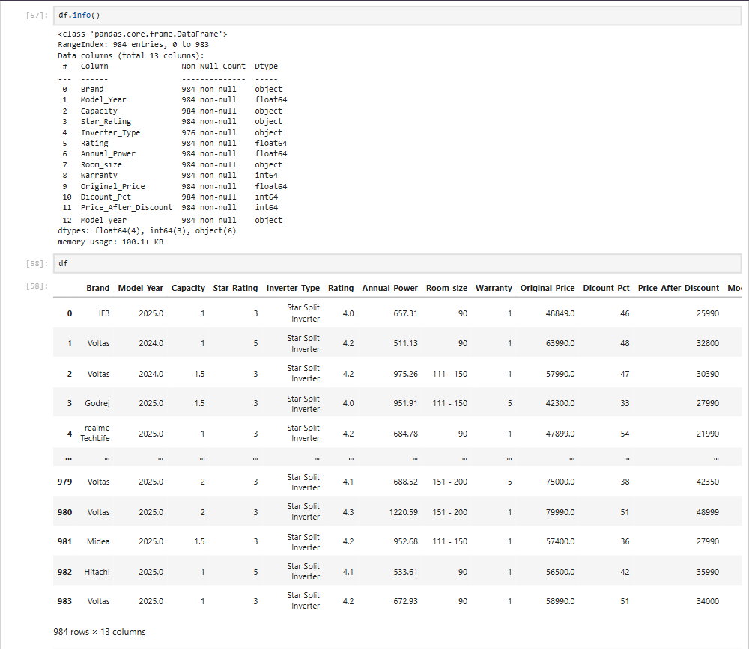
Data Cleaning Steps:
Standardized brand names by identifying and correcting multi-word entries (e.G., "Realme techlife", "blue star") and splitting or normalizing inconsistent values for consistency.
Converted columns like model_year, star_rating, and price_after_discount from categorical to numerical formats, as they represent measurable values.
Detected missing values using the isnull() method and handled them with suitable imputation techniques, such as mean for numerical and mode for categorical ,using the fillna() method.
Checked for duplicates, validated data types, and handled missing values to ensure the dataset was ready for analysis.

Slide 9
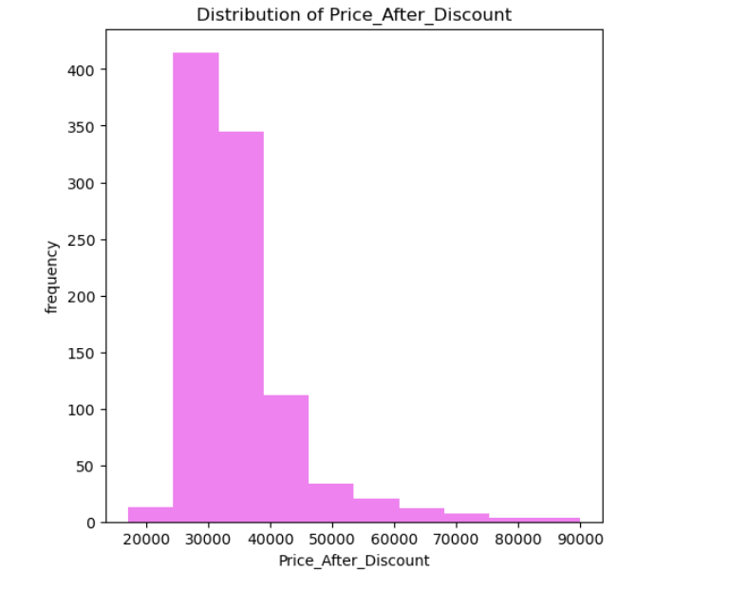
Data Visualization:
Univariate analysis:-
Histogram Plot:-
- In the above Plot we can observe the distribution of the Price_After_Discount of AC's that lies between 25000-45000.- we can observe that AC's which are above 60000 are very less and these can be considered under expensive category.

Slide 10
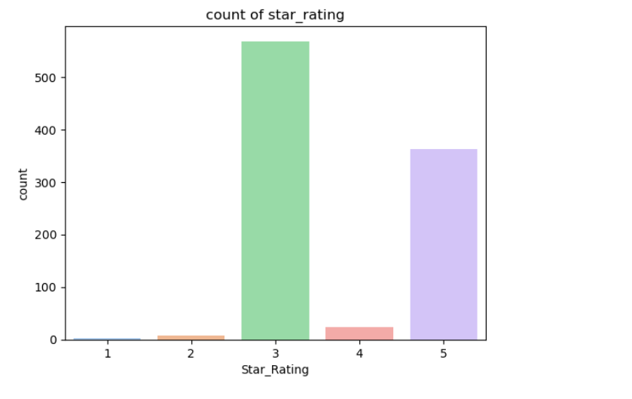
Data Visualization:
Count plot:-
- In this count plot we can observe that most of the AC's are having 3 and 5 star energy rating that shows the impact on power usage.

Slide 11
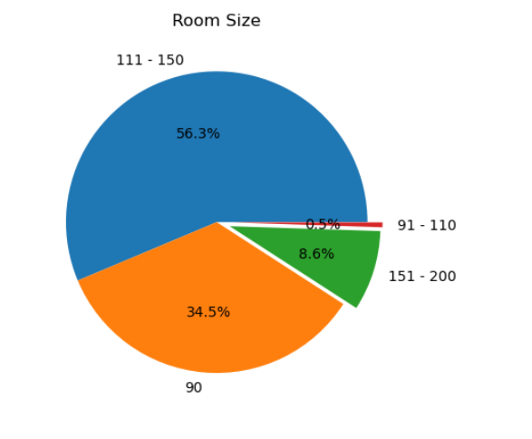
Data Visualization:
Pie Plot:-
In this plot we can observe the percentages of Room-Size that are compatible for the AC's Performance.

Slide 12
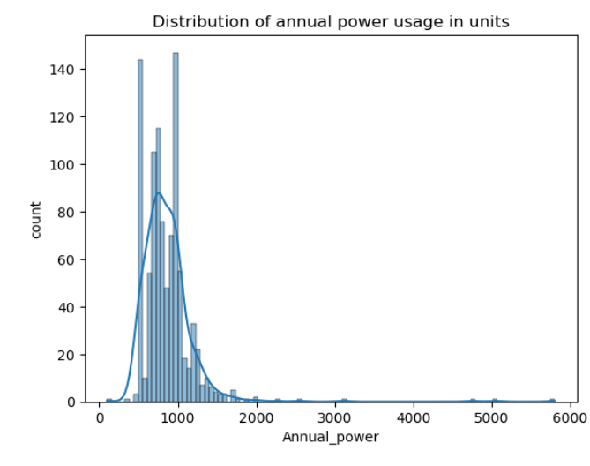
Data Visualization:
Distribution Plot:-
In the above plot we can observe Distribution of annual power usage in units it is positively skewed and the most of the Ac's power consumption lies between 500 - 1500 and there are only few Ac's which cosumpts more power greater than 2000 units annually .

Slide 13
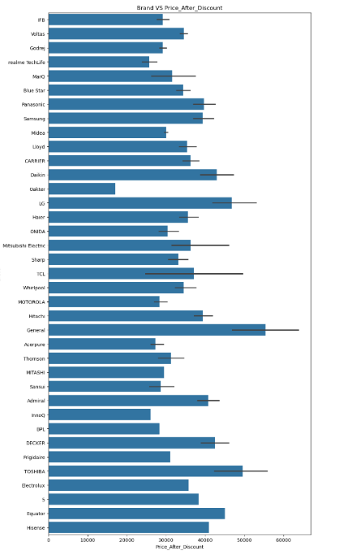
Data Visualization:
Bivariate analysis:-
Bar Plot:-
In the above plot we can observe that few Brands like General, Toshiba, LG, Daikin, Admiral are costlier as compared to Remaining Brands ,so if try to provide more discounts or any other offers on these Brands we can see a huge raise in these brands also.

Slide 14
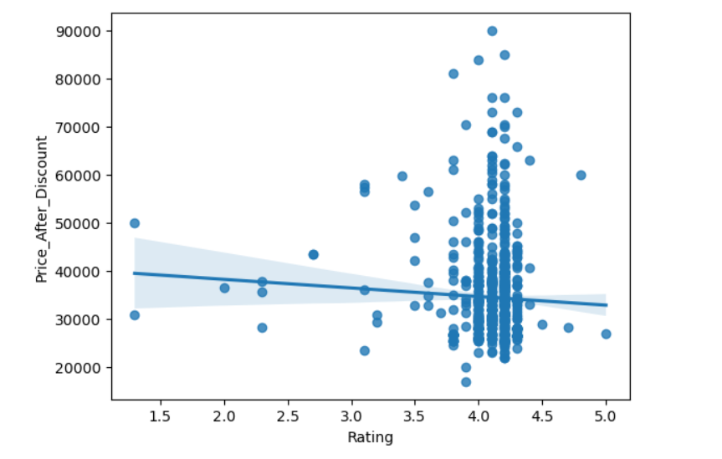
Data Visualization:
Reg Plot:-
In this plot we can observe that the Ac's which are priced between 25000-60000 maximum of them having ratings in between 4.0-4.5 if improve the efficiency of the Ac's and also improve the Factors which are effecting the rating so we can improve the sales of Ac's Based on that.

Slide 15
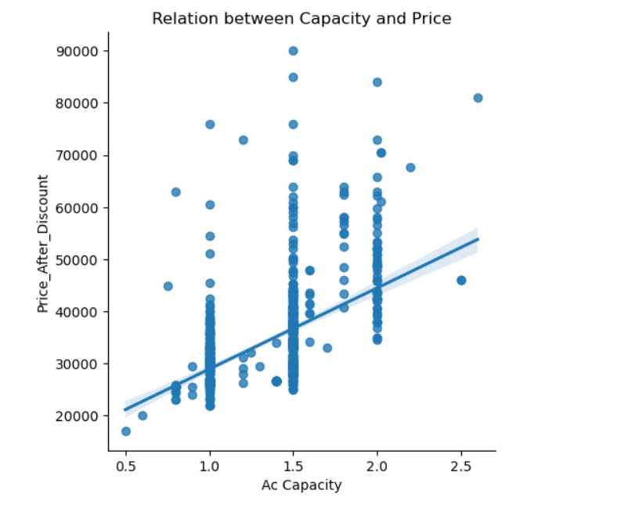
Data Visualization:
LM Plot:-
In this plot we can observe that the relation line is positvely increasing from this we understand as the Capacity is incresing the price is also incresing.To improve sales we can market based on capacity as 1 ton ac's are budget friendly and cosumes less power , 1.5 are used for medium spaces and gives powerfull cooling and 2 - 2.5 ac's are used in large spaces and gives powerful cooling compared to other capacity ac's.

Slide 16
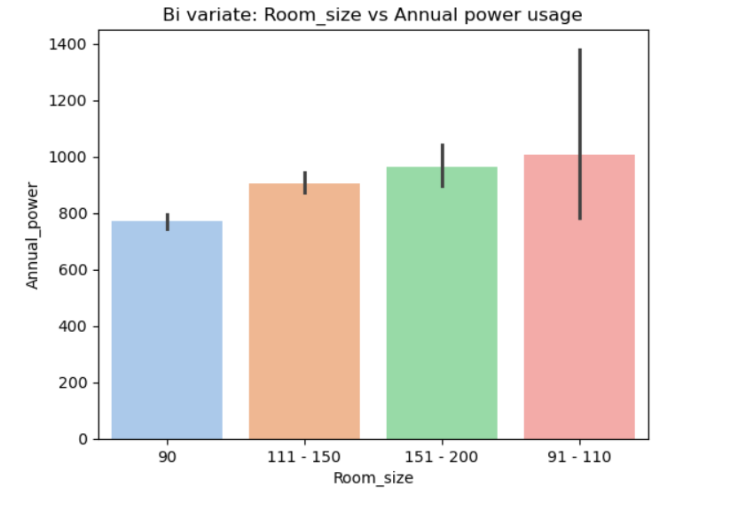
Data Visualization:
Bar Plot:-
In this plot we can observe relation between Annual power usage and RoomSize . We can observe that annual power usage is not based on the Room Size- we can suggest the Ac's manufacturers to Build Ac's that cosume power based on the room size- This is also one of the factor that is affecting the sales.

Slide 17
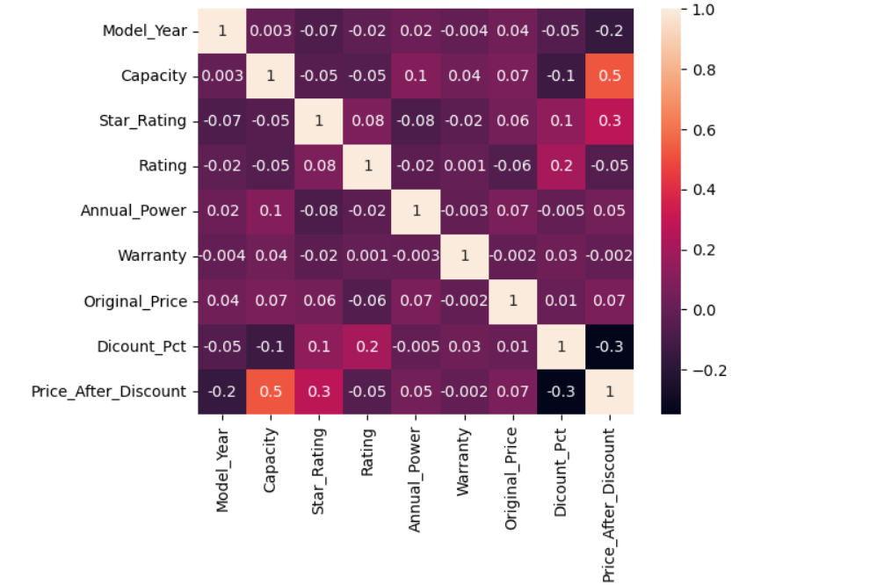
Data Visualization:
multivariate analysis:_
Heat Map:-
This plot shows relation between all numerical columns present in the data- From the correlation heatmap, we can see that AC capacity has a strong positive correlation with price.- while discount percentage shows a negative correlation, indicating that larger capacity models are priced higher and discounts significantly reduce the final price.- Based on the negative relation we should provide dicounts on larger capacity models so it might help in sales.

Slide 18
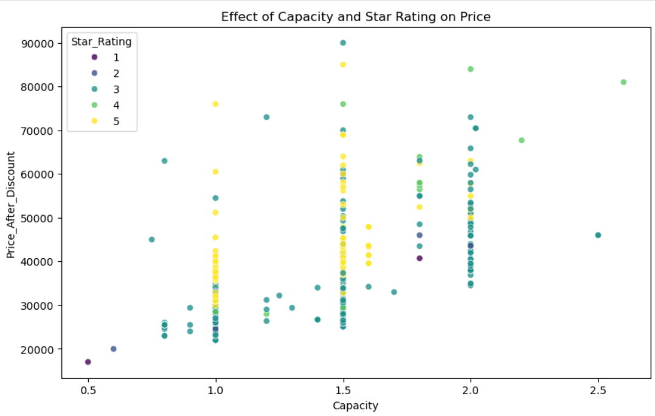
Data Visualization:
Scatter Plot:-
The plot shows that AC price increases with capacity, and within each capacity, higher star-rated models tend to have slightly higher prices, reflecting the added value of energy efficiency.- To improve sales ,we have to focus on promoting energy-efficiency based on star rating and also prove offers and high lighting the long term savings.

Slide 19
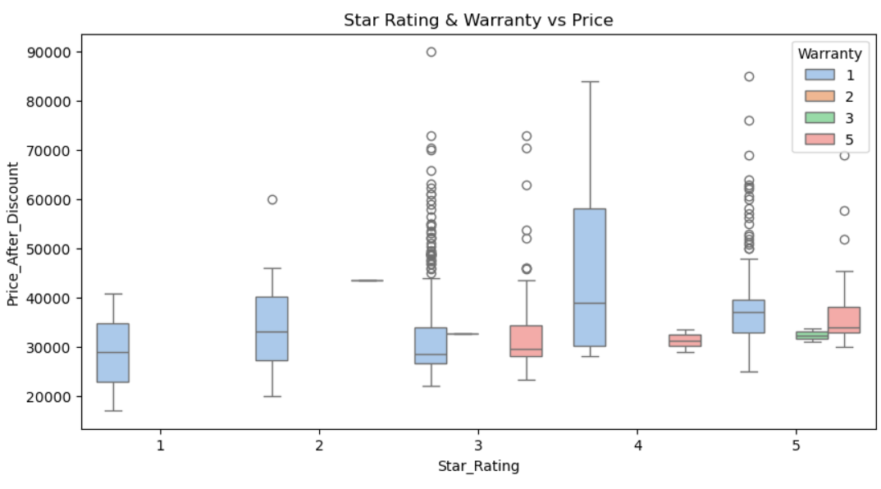
Data Visualization:
Box Plot:-
The plot shows that higher star ratings and longer warranties are associated with higher prices, suggesting that promoting energy efficiency along with extended warranty offers can effectively boost customer trust and sales.

Slide 20
Key Business Questions
What is the price distribution across different AC capacities
How does the price vary by star rating
What is the correlation between different numerical columns
How does annual power consumption vary across different Room_Sizes
What is the distribution of annual power consumption

Slide 21
Conclusion:
This project transformed Flipkart AC data into clear and meaningful insights.
It analyzed prices, features, and ratings to understand market trends and customer preferences.
The insights highlight which brands and models offer the best value for money.
These findings help buyers make smarter, faster, and more confident purchase decisions.

Slide 22

Any questions

Slide 23
Experience– Web Scraping & Data Analysis:
Scraped Air conditioners data from Flipkart website using BeautifulSoup, pandas And Regex.
Cleaned and standardized data ('Brand', 'Model_Year', 'Capacity', 'Star_Rating','Inverter_Type', 'Rating', 'Annual_Power', 'Room_size', 'Warranty‘.etc..,
Created visualizations to improve sales of Ac’s from flipkart.
Learned end-to-end data workflow: scraping → cleaning → analysis → visualization.

Slide 24
Challenges – Web Scraping & Data Analysis:
Dynamic webpage where data reloads and updates frequently.
Inconsistent HTML structures across product pages.
Missing or incomplete product details during extraction.
Handling duplicate and unclean scraped data.
Handling slow extraction due to dynamic page loading.
Selecting the most relevant visuals for insightful analysis.

Slide 25


